Slide 1
Observations of precursors to Tropical Cyclone activity in the Caribbean and the Main Developing Region
Keneshia Hibbert
NOAA EPP/MSI Graduate Fellow
Mentors/Advisors:
Dr. Jorge Gonzalez and Thomas Smith

Slide 2
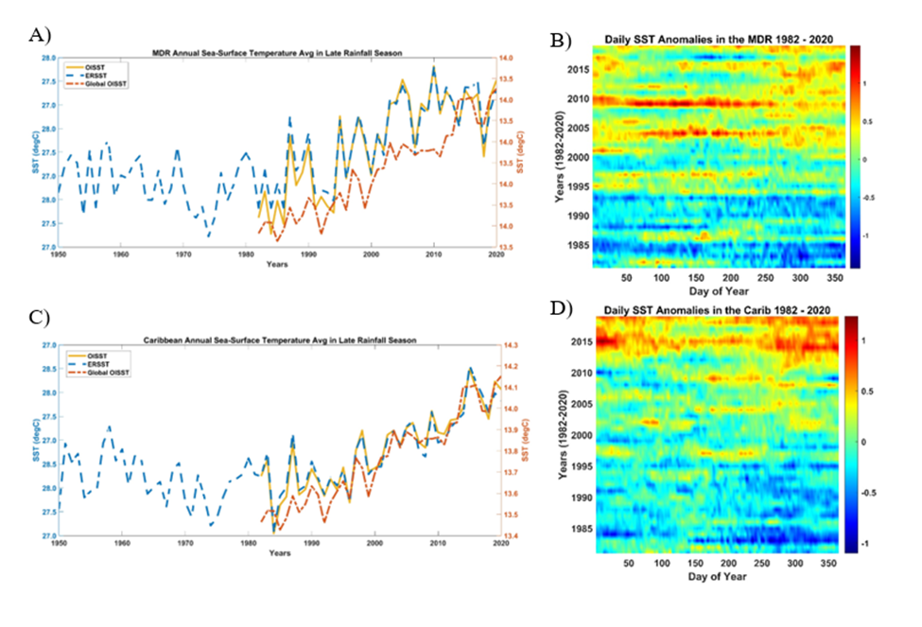
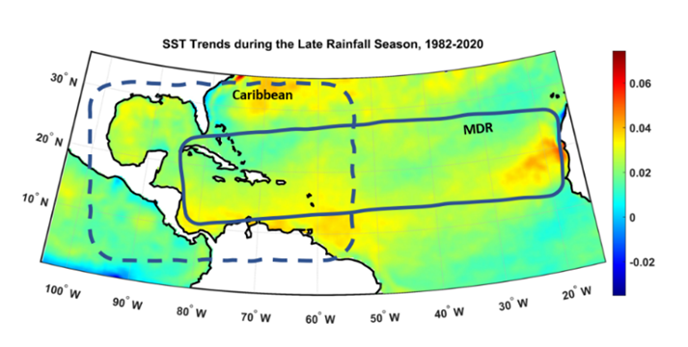
Research Question Are changes to TC precursors affecting TC development and intensification ?
Spatial Map depicting trends from 1982 to 2020 during the Late Rainfall Season (LRS), indicating warming trends up to and exceeding 0.4°C per decade in the Main Developing Region (MDR) (10°N-20°N, 20°W-80°W), and the Caribbean and the Surrounding Region (5°N -31°N, 100°W -55°W).
Annual SST trends and daily anomalies. (a,c) annual average SSTs during the LRS for the MDR and the Caribbean and surrounding region, depicting current and global SST trends from 1982-2020 using the NOAA OISST and 1950-2020 ERSST dataset (b,d) regional daily SST anomalies during the LRS for the MDR and the Caribbean and the surrounding region

Slide 3
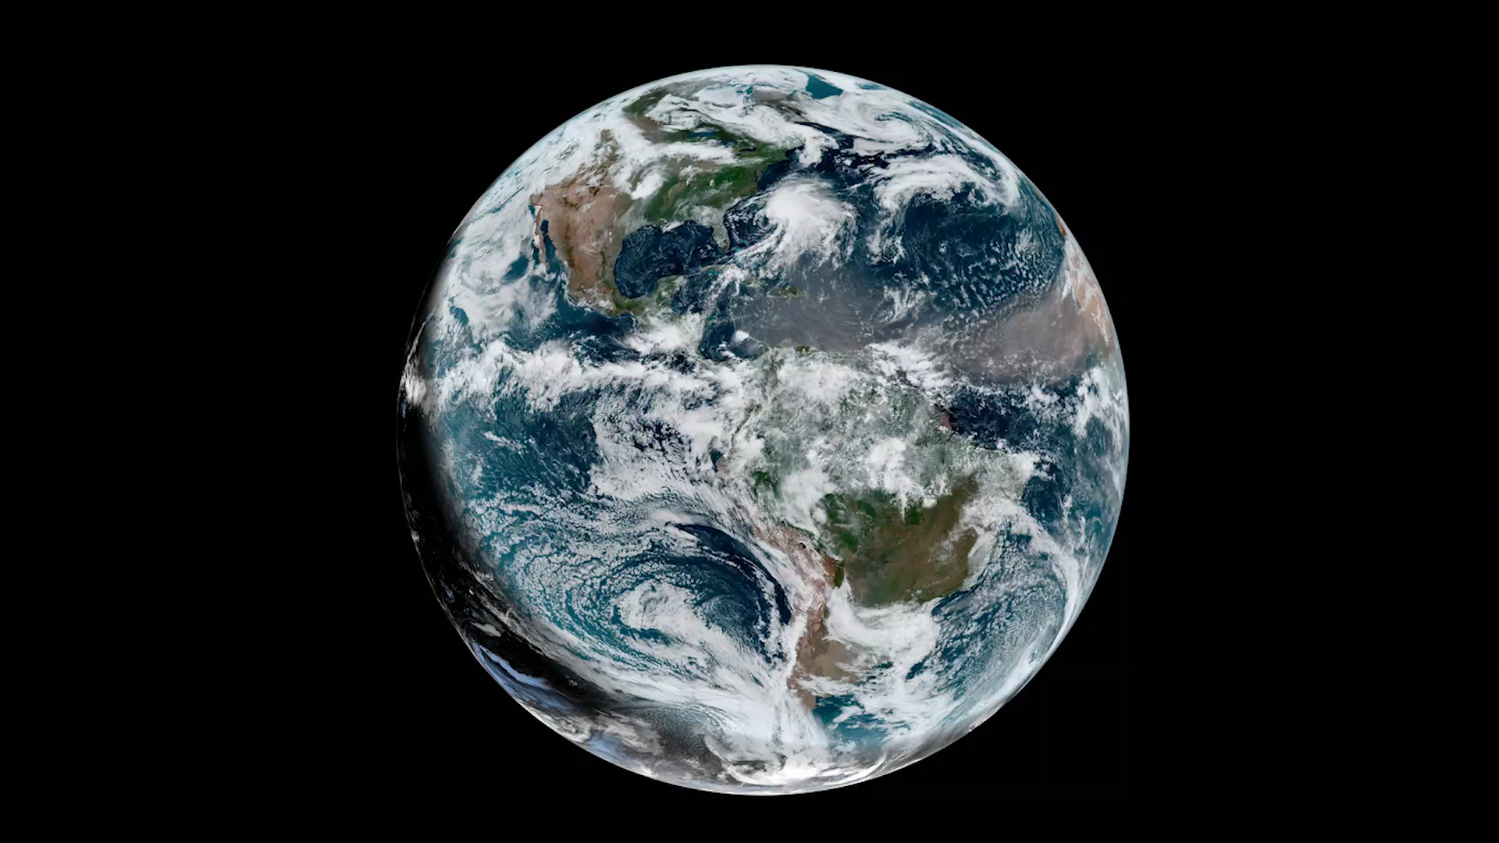
Possible Research Project What are other precursors to TC could we explore?
Ocean Heat Content
Mixed-Layer Depth Analysis
EL Nino Southern Oscillation (ENSO)
Your ideas???
Time period of interest: 1982-2020

Slide 4
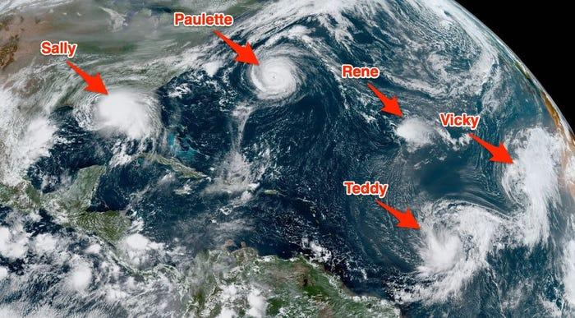
Research Outcomes
5 Tropical Cyclone in Atlantic Basin in 2020
Learn how to make maps
Learn how to make time series (plots) – using MATLAB or Excel
Learn how to find/gather and use data
Learn about how global warming affects our oceans and how that relates to hurricanes and the future
Learn how to effectively communicate scientific information to the public
Source: NOAA GEOS-East

Slide 5
Summary
Source: NOAA
The goal of this work is to reduce loss of life, economic devastations, and improve natural disaster response strategies

